Slide 1
Chapter 23
Urbanization

Slide 2
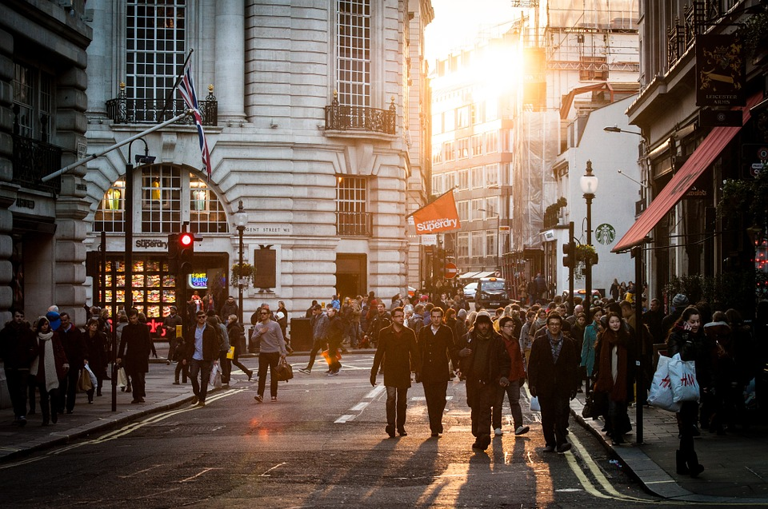
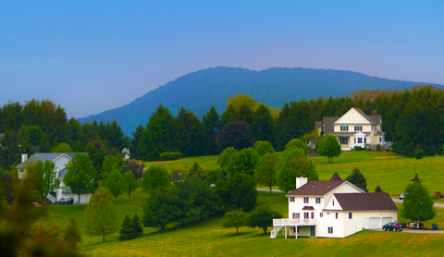
Urbanization
Urban
  High Population Density
  More than 2500 people
  City
Rural
  Low Population Density
  Less than 2500 people
  Countryside
  Agricultural

Slide 3
Urban Vocabulary
Urbanization
  Creation & growth of urban & suburban areas.
Urban Growth
  Rate of increase of the urban population.
Urban Sprawl
  Low population density development at edges of cities.

Slide 4
Urban Sprawl
When land is available and affordable, urban areas tend to sprawl outward because:
  Low-cost gasoline and government funding of highways encourages automobile use.
  Tax-laws encourage home ownership.
  Higher city taxes
  Less population density
  Many urban areas lack proper planning.
  Historically wealth = ability to move out of the city.
  Escape crime
  Better suburban schools

Slide 5
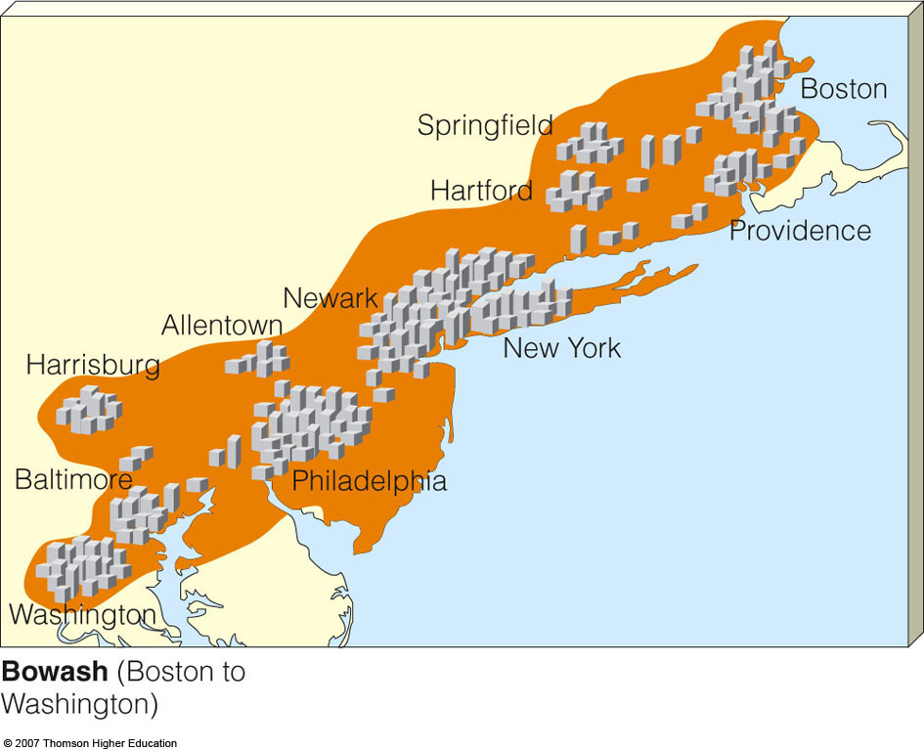
Urban Sprawl
As they grow and sprawl outward, urban areas merge to form megalopolis.
  Bowash runs from Boston, Massachusetts to Washington, D.C.
Figure 23-7

Slide 6
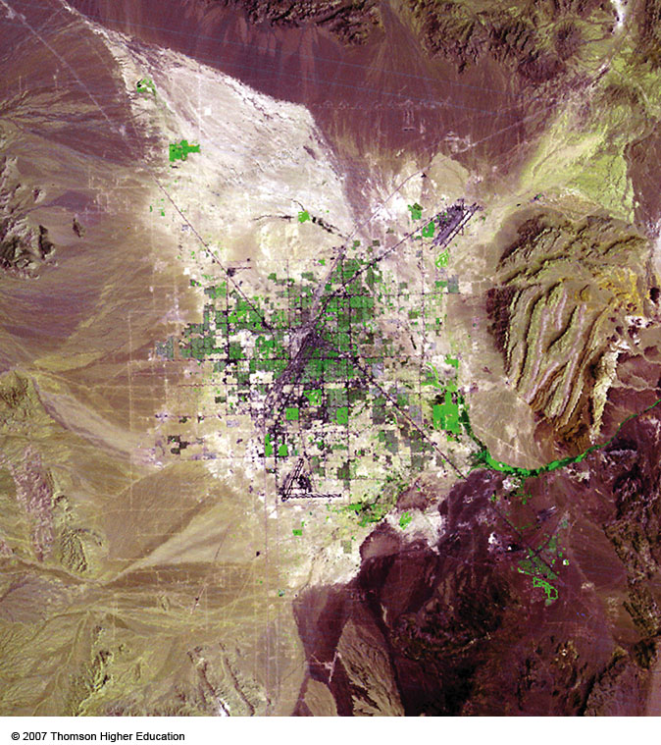
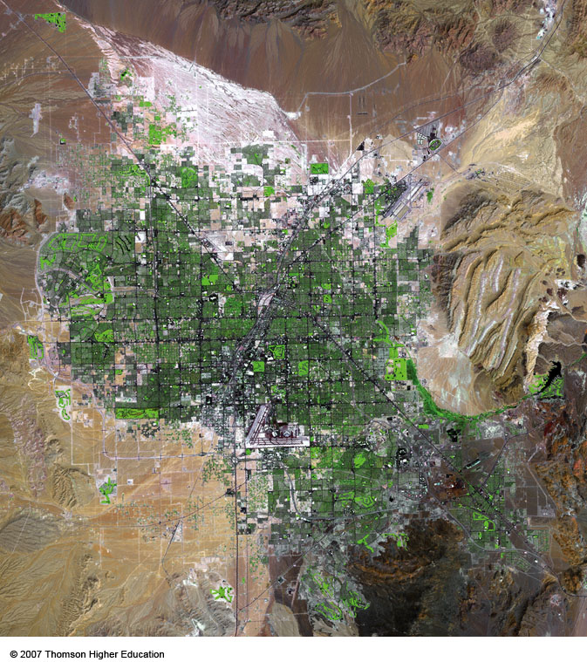
Urban Sprawl
Urban sprawl in and around Las Vegas, Nevada between 1973 and 2000.
Figure 23-5

Slide 7
URBANIZATION AND URBAN GROWTH
People move to cities because “push” factors force them out of rural areas and “pull” factors give them the hope of finding jobs and a better life in the city.
Push factors – better jobs, cheaper housing, more resources, better education.
Pull factors – education, medical, religious, cultural
Urban populations are growing rapidly and many cities in developing countries have become centers of poverty.

Slide 8
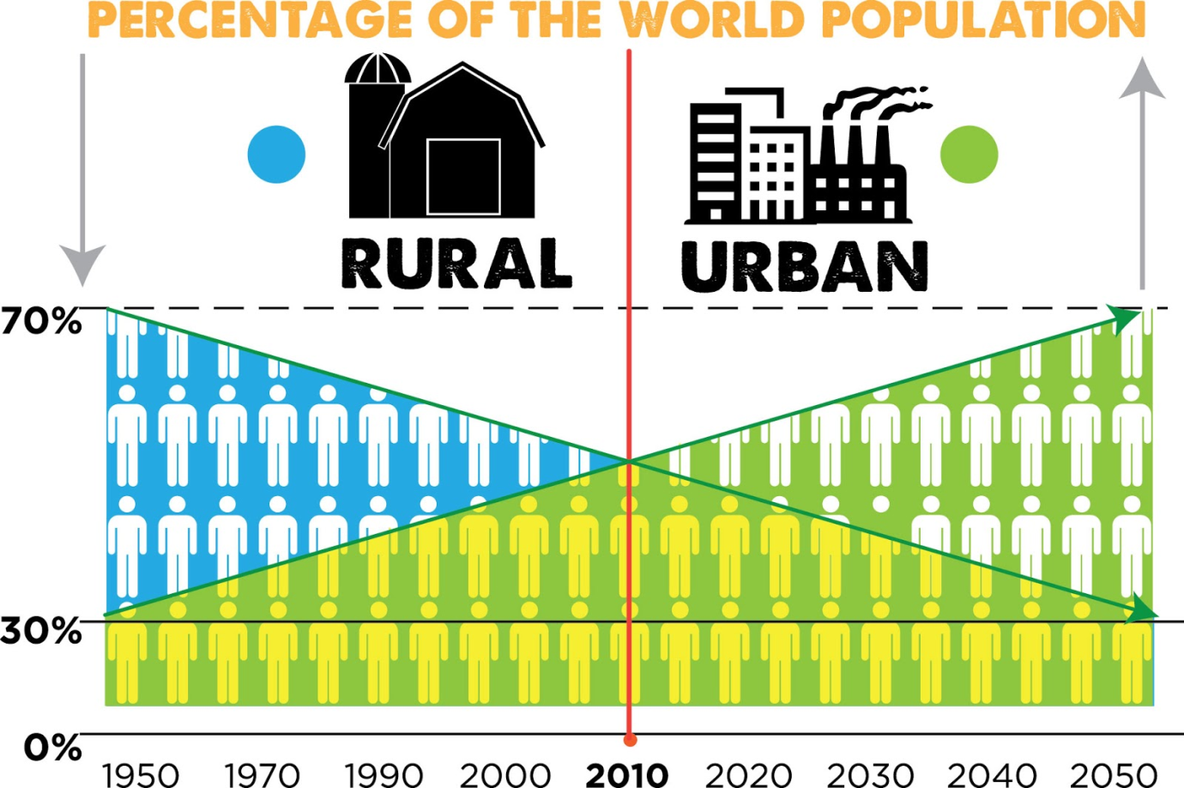
Historically more people lived in rural areas – agriculture.
Today 50-50 split.
Future sees more people in urban areas. Why?

Slide 9
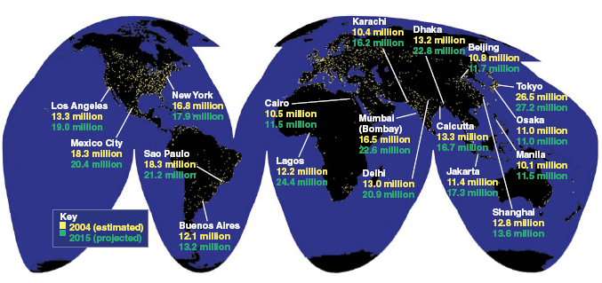
Major Urban Areas of the World
Satellite images of the earth at night showing city lights. Currently, 49% of the world’s population live in urban areas (2% of earth’s land area).
Figure 23-2

Slide 10
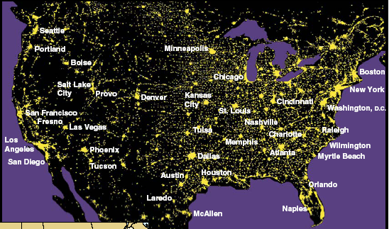
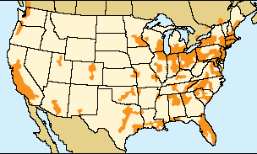
Case Study: Urbanization in the U.S.
8 of 10 Americans live in Urban areas.
About 48% of Americans live in consolidated metropolitan areas (bottom map).
Figure 23-4

Slide 11
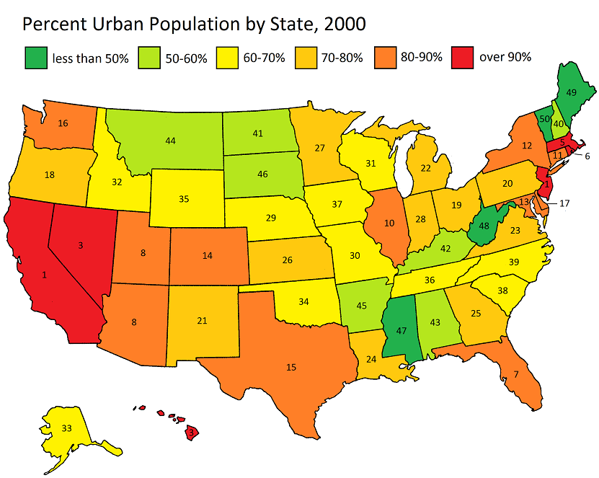

Slide 12
US Patterns
Rural to Cities
  54% of population lives in 51 urban areas. Over 1 million people.
Cities to Suburbs
  50% of urban dwellers actually live in Suburbs.
N & E to S & W
  1980-2009 80% of US Population growth occurred in Southern & Western states. Nevada, Colorado & Florida were the highest.

Slide 13
Land Use Planning
What is zoning?
Designating space/land for specific use
  Residential
  Industrial
  Business
  Infrastructure – Easements, Right of ways, etc.

Slide 14
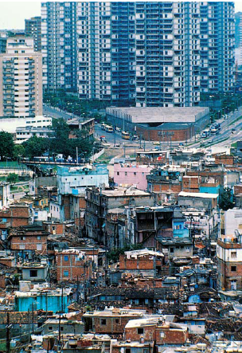
Pros & Cons of Urbanization
Economic
Urban areas can offer more job opportunities, tax incentives, revenue, growing industry, better education and health care.
Problems include – overcrowding, increased costs for housing; increased poverty.

Slide 15
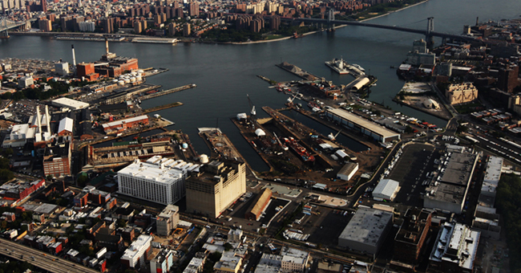
Pros & Cons of Urbanization
Industrial
Urban areas can be economic & technological centers.
Problems include – competition, higher prices, higher taxes.

Slide 16
Pros & Cons of Urbanization
Environmental
Pros – Confine development to smaller area, better sanitation, mass transit, pedestrian friendly.
Cons – High waste output, concentrated water & air pollution, noise pollution, heat islands.

Slide 17
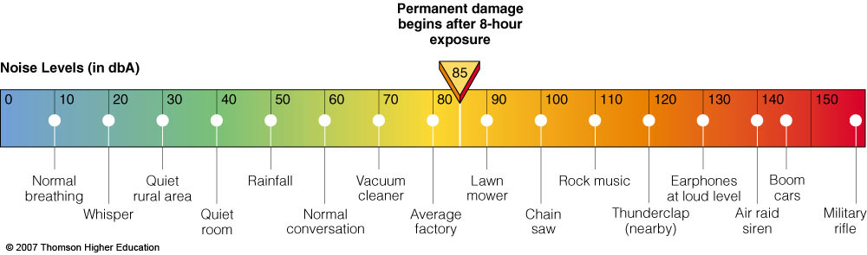
URBAN RESOURCE AND ENVIRONMENTAL PROBLEMS
Noise levels of some common sounds. Prolonged exposure to lower noise levels and occasional loud sounds can greatly increase internal stress.
Figure 23-9

Slide 18
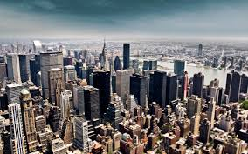
Pros & Cons of Urbanization
Ecological
Pros – Confine development to smaller area.
Cons – Loss of natural habitats, increased scavenger populations (sea gulls)

Slide 19
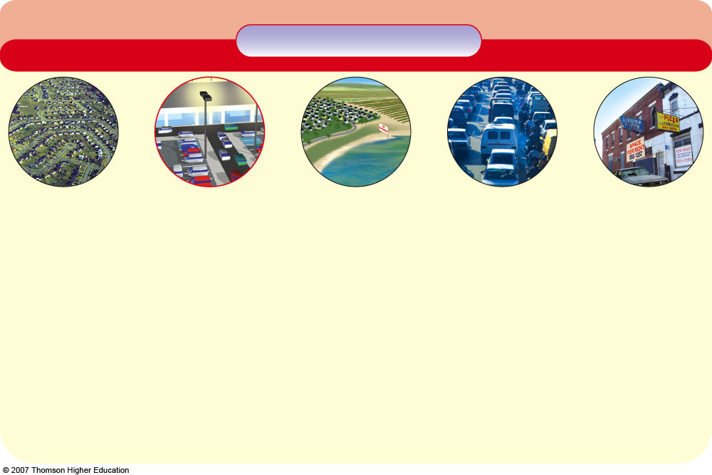
Natural Capital Degradation
Urban Sprawl
Land and Biodiversity
Human Health and Aesthetics
Water
Energy, Air, and Climate
Economic Effects
Increased runoff
Loss of cropland
Contaminated drinking water and air
Increased surface water & groundwater pollution
Increased energy use & waste
Higher taxes
Loss of forests and grasslands
Increased air pollution
Decline of downtown business districts
Increased use of surface water and groundwater
Loss of wetlands
Weight gain
Increased greenhouse gas emissions
Loss and fragmentation of wildlife habitats
Noise pollution
Decreased storage of surface water and groundwater
Increased unemployment in central city
Sky illumination at night
Enhanced global warming
Increased wildlife roadkill
Increased flooding
Warmer microclimate (urban heat island effect)
Increased soil erosion
Traffic congestion
Decreased natural sewage treatment
Loss of tax base in central city
Fig. 23-6, p. 553
Notes:
Figure 23.6
Natural capital degradation: some undesirable impacts of urban sprawl or car-dependent development. QUESTION: Which five of these effects do you think are the most harmful?

Slide 20
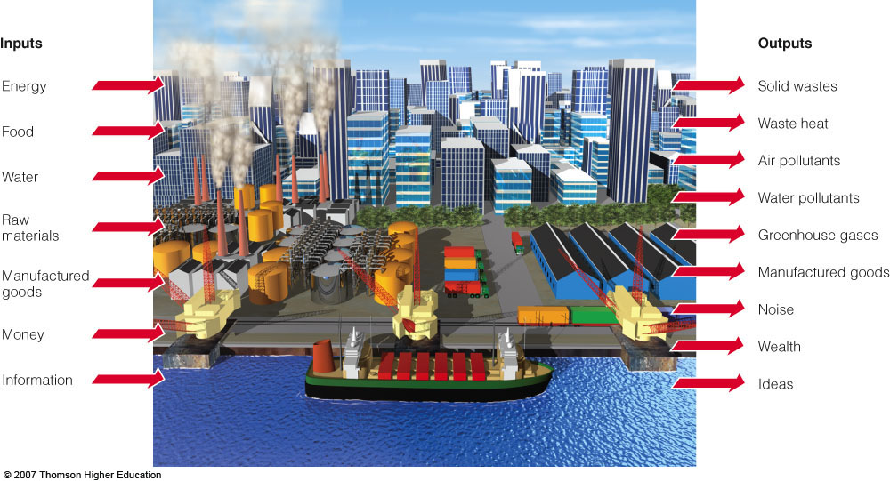
URBAN RESOURCE AND ENVIRONMENTAL PROBLEMS
Urban areas rarely are sustainable systems.
Figure 23-8

Slide 21
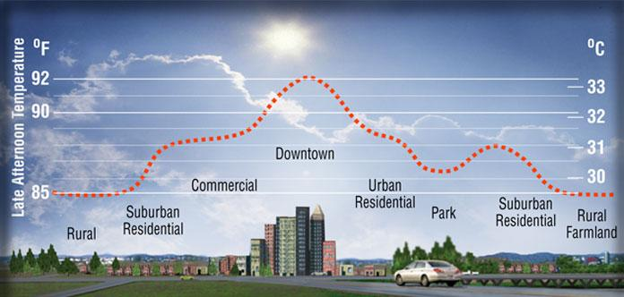
Heat Island Effect

Slide 22
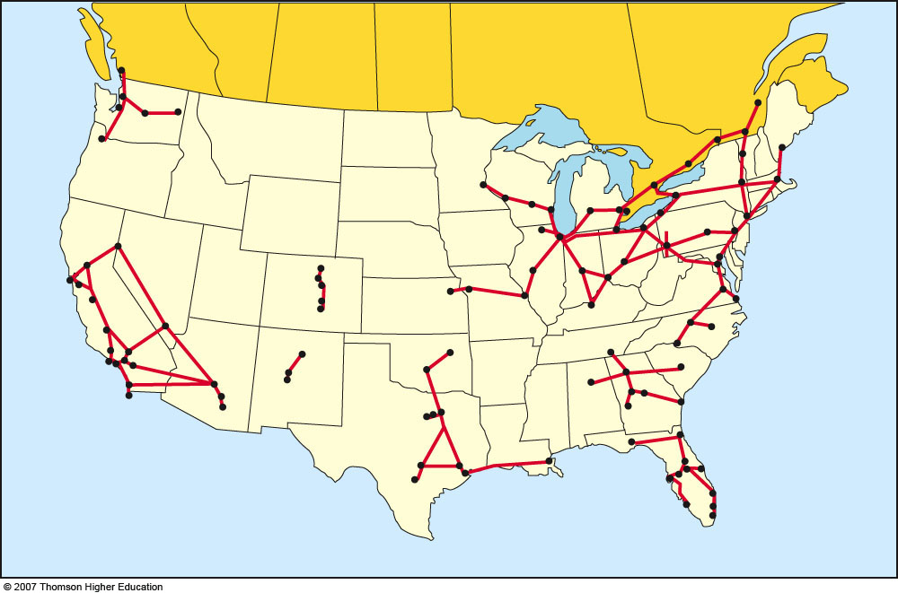
Potential routes for high-speed bullet trains in the U.S and parts of Canada.
  If Americans doubled their use of mass transit from 5% to 10%, this would reduce U.S. dependence on oil by 40%.

Slide 23
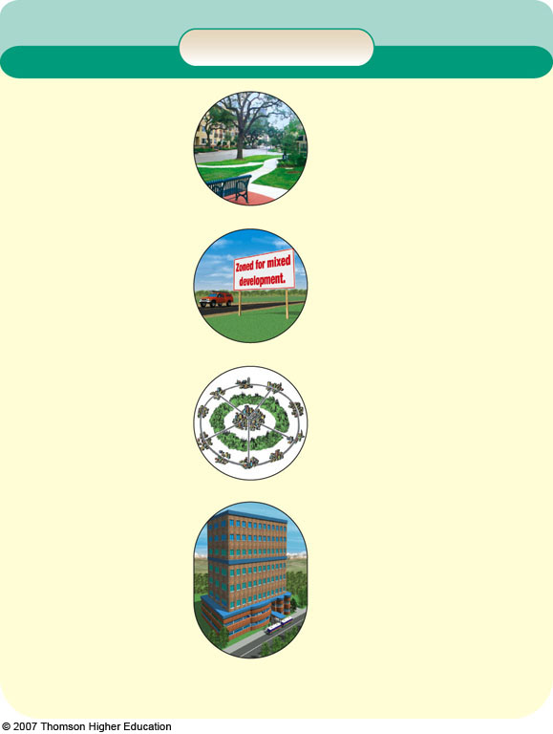
Solutions
Smart Growth Tools
Limits and Regulations
Limit building permits
Urban growth boundaries
Greenbelts around cities
Public review of new development
Protection
Preserve existing open space
Buy new open space
Buy development rights that prohibit certain types of development on land parcels
Zoning
Encourage mixed use
Concentrate development along mass transportation routes
Promote high-density cluster housing developments
Taxes
Tax land, not buildings
Tax land on value of actual use (such as forest and agriculture) instead of highest value as developed land
Tax Breaks
For owners agreeing legally to not allow certain types of development (conservation easements)
For cleaning up and developing abandoned urban sites (brownfields)
Planning
Ecological land-use planning
Environmental impact analysis
Integrated regional planning
State and national planning
Revitalization & New Growth
Revitalize existing towns & cities
Build well-planned new towns and villages within cities
Fig. 23-16, p. 563
Notes:
Figure 23.16
Solutions: smart growth or new urbanism tools used to prevent and control urban growth and sprawl. QUESTIONS: Which five of these tools do you think are the most important ways to prevent or control urban sprawl? Which, if any, of these tools are being used in your community?

